Slide 1

ML22/23 Scalar Encoder with Buckets
Team_SpiralGanglions
Sahith Kumar Singari -1446809
Anil Kumar Gadiraju-1428607
Vinay Kumar Bandaru - 1447125

Slide 2
OBJECTIVE
The objective of the paper is to evaluate the limitations of Scalar Encoder and propose a solution by combining it with Buckets Without Buckets concept it is less versatile, Limited Precision and Lack of adaptability. This paper evaluates the limitations of the Scalar Encoder and how they can be addressed by combining the Scalar Encoder with Buckets.
By introducing the concept of Buckets, the paper seeks to provide a more precise and efficient method for encoding data, particularly in scenarios where periodic encoding of values is needed. Overall, the objective of the paper is to enhance the performance and accuracy of Scalar Encoder in real-world applications, particularly in sensor data analysis.
Notes:
Sahith

Slide 3

TABLE OF CONTENTS
Introduction
Methodology
Implementation of Buckets
Results
Conclusion

Slide 4

INTRODUCTION
Scalar encoder with buckets is a method of transforming continuous data into discrete values that can be utilized for analysis, modeling, and machine learning. It entails segmenting continuous values into intervals or "buckets" and assigning them to the appropriate buckets.
Scientists study the cortex to understand sequence learning, and models based on neural readings are used to recognize sequences. However, these models may not work in real-world situations. Hierarchical Temporal Memory (HTM) is a biomimetic model based on the neocortex's features, which has shown promise in pattern recognition and learning the sequences and flow of sensory inputs.
Notes:
Vinay

Slide 5
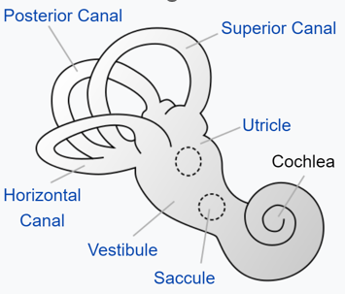
The encoding mechanism in HTM is comparable to how human and animal sensory organs work.
A system that transforms environmental noises into a sparse group of active neurons is the cochlea. In HTM's language, Sparse Distributed Representations (SDRs) are employed, with a fixed number of active bits that carry semantic significance.
In SDR, which is critical in HTM learning, two inputs with comparable semantic meaning must have equal active bit representation.HTM is built on the concept of SDRs, which are high-dimensional binary vectors with only a tiny percentage of their bits set to 1.
Fig 1:Innerparts of the ear.
Notes:
Vinay

Slide 6
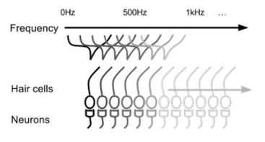
Because they allow for the efficient storing and processing of vast volumes of information, SDRs are a natural way for the brain to represent patterns.
To use HTM, data must first be transformed into an SDR using an encoder that captures the data's significant semantic properties.
The HTM model is based on how one layer of the brain functions and is designed to learn from continuous streams of input patterns to create sparse and stable representations of input sequences.
One of the key capabilities of HTM is its ability to predict future patterns based on previously learned patterns. The input patterns must be unique and not repeat to ensure the accuracy of the predictions.
Fig.2: Cochlear hair cells excite a group of neurons based on the frequency of the sound.
Notes:
Vinay

Slide 7
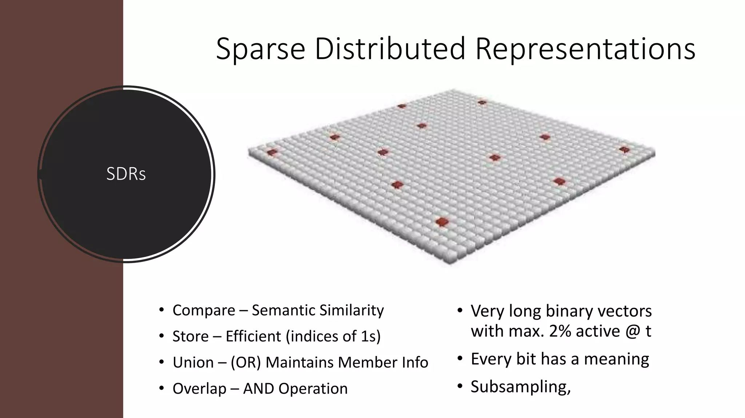
Methodology
Spatial Pooler maps active columns' cells during SDR input creation.
Implementing inhibitory mechanism results in constrained representation of input with similar patterns resulting in similar activation columns.
Learning occurs through synapse persistence updates, with active bits enhancing persistence and inactive columns being boosted to ensure participation in training.
SDR is a sparse information organization system, meaning only a small fraction of the cells are active at any given time.
Fig3:SDR Diagram contains Active columns
Notes:
Anil

Slide 8
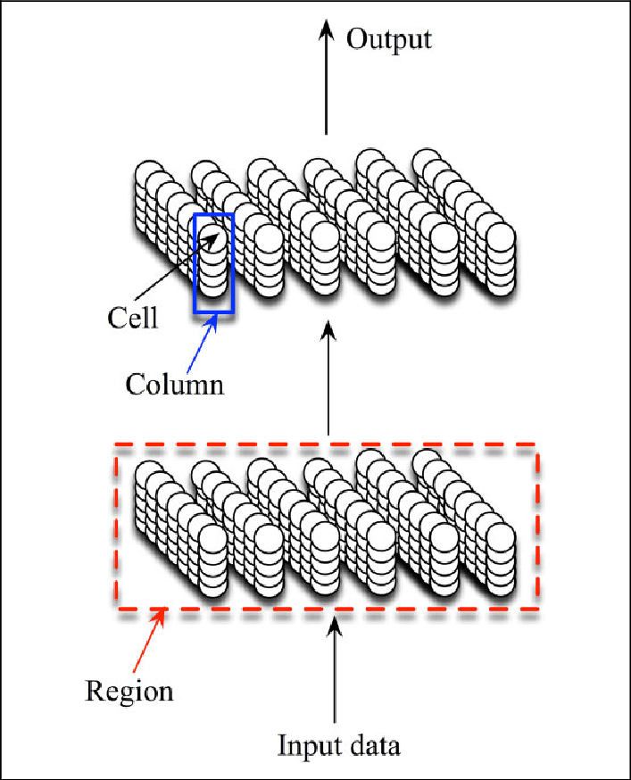
Active cells in SDR are distributed throughout the region to represent the region's activity.
The binary representation of SDR in HTM is highly computationally efficient and does not result in a functional loss of information due to critical features of SDR.
Buckets are used to divide a continuous value range into consistently sized intervals.
The width of each bucket is calculated by dividing the range of values by the number of buckets needed.
Fixed-width bucketing is a basic and extensively used scalar encoding technique, although it may not be suitable for data with irregular distribution.
Fig5:A Section Of HTM Region
Notes:
Anil

Slide 9
Implementation
Understand the components of data to design an effective encoder.
Divide the value range into buckets and map them to active cells to build the encoder implementation.
A scalar encoder is a device that converts a numeric (floating point) value to a bit array. The output is entirely 0's with the exception of a continuous block of 1's whose placement changes in real time as the input value changes.
The encoder was developed with the aim of mapping continuous scalar data onto a defined range of integers to encode them into sparse distributed representations (SDRs).
The encoder calculates the SDR's bit count and bucket width by first calculating a scaling factor and a resolution.
The scalar encoder with buckets uses a clustering technique to classify similar values into buckets of the same size, making it more effective than a scalar encoder with a set bucket width when dealing with uneven data distributions.
Notes:
Anil

Slide 10
ClosenessScores: Calculates the closeness score of an input value to each bucket range.Returns a list of activation levels for each bucket. EncodeIntoArray:Maps input values to continuous ranges of buckets instead of individual buckets.Returns an encoded array of activation levels for each bucket. Decode: Decodes the encoded array back to the original input values.Uses the same parameters as the Decode method. GetBucketIndex: Supports periodic encoding of values. Returns the index of the bucket that an input value belongs to. GetTopDownMapping: Automatically generates a hierarchy of levels for the bucket ranges based on their size. Returns a list of levels and their corresponding bucket ranges. GenerateRangeDescription: Generates a description of the bucket ranges used to encode the data. Returns a string describing the bucket ranges and their parameters. GetBucketInfo: Provides information on the parameters used to create the bucket ranges, such as the min and max values and the bucket size. Returns a dictionary of the parameters for each bucket range. GetBucketValues: Returns the list of bucket values for a given bucket range. Useful for encoding cyclical data with periodic encoding.
Notes:
Sahith

Slide 11
Result
From all the testcases carried out in the training phase Increased Precision: The method EncodeIntoArray in the Scalar Encoder with Buckets maps input values to continuous ranges of buckets instead of individual buckets, allowing for better precision in encoding data. The ClosenessScores method calculates the closeness score of an input value to each bucket range, indicating the level of activation for each bucket range. This provides a more precise encoding of input data compared to the Scalar Encoder, where the input values are mapped to individual buckets.
Improved Flexibility: The Scalar Encoder with Buckets automatically sets parameters such as the number of buckets and bucket size based on the input data, making it more flexible and easier to adapt to different datasets. The GenerateRangeDescription method generates a description of the bucket ranges used to encode the input data, which can help users understand the encoding scheme and adjust the parameters as needed. This increases the flexibility of the Scalar Encoder with Buckets and makes it easier to adapt to different datasets.
Periodic encoding: The Scalar Encoder with Buckets supports periodic encoding of values, allowing for better handling of cyclical data. The GetTopDownMapping method generates a mapping of the bucket ranges to a hierarchy of levels, which can be useful for representing cyclical data such as time of day or day of the week. The GetBucketValues method returns the list of bucket values for a given bucket range, allowing users to encode cyclical data using a periodic encoding scheme.
Improved Encoding Scheme: The Scalar Encoder with Buckets provides an improved encoding scheme compared to the Scalar Encoder by using continuous ranges of buckets instead of individual buckets. The GetBucketIndex method returns the index of the bucket range that an input value belongs to, allowing for a more efficient encoding of data. The decode method can be used to decode the encoded data back to the original input values, providing a lossless representation of the data. This improved encoding scheme can overcome the limited precision and inflexibility of the Scalar Encoder and provide better performance.
Notes:
Sahith

Slide 12
CONCLUSION
In conclusion, the Scalar Encoder with Buckets is an improved version of the Scalar Encoder that overcomes some of its limitations. By mapping input values to continuous ranges of buckets, the Scalar Encoder with Buckets provides better precision in encoding data compared to the Scalar Encoder. The automatic setting of parameters such as the number of buckets and bucket size based on the input data, as well as the generation of a bucket range description, increases the flexibility of the Scalar Encoder with Buckets and makes it easier to adapt to different datasets. Furthermore, by supporting periodic encoding of values, the Scalar Encoder with Buckets can handle cyclical data more effectively.
Notes:
Sahith

Slide 13
References
[1] | S. &. H. .. Ahmad, “ “Properties of sparse distributed representations and their application to hierarchical temporal memory.,”,” 2011. [Online]. Available: doi: 10.1371/journal.pone.0022149.
[2] | S. A. J. Hawkins, ““Why neurons have thousands of synapses, a theory of sequence memory in neocortex,”,” 2016. [Online]. Available: https://www.frontiersin.org/articles/10.3389/fncir.2016.00023/full.
[3] | S. Purdy, “Encoding Data for HTM Systems,” [Online]. Available: https://arxiv.org/ftp/arxiv/papers/1602/1602.05925.pdf.
[4] | “Scalar Encoders,” [Online]. Available: https://arxiv.org/ftp/arxiv/papers/1602/1602.05925.pdf.
[5] | S. P. S. Ahmad, “Spatial Pooling with Hierarchical Temporal Memory,” [Online]. Available: https://arxiv.org/abs/1705.05363.

Slide 14
Thank You Team_SpiralGanglion

